Slide 1
Substance and non substance addiction
Name: Aqsa Fayyaz

Slide 2
Learning outcomes
In this lecture, the students will be able to understand:
The difference between chemical and non chemical addiction
Impact of chemical/drug addiction on a person

Slide 3
Important terminologes
Drug: A drug is defined as any substance /chemical that produces changes in our bodies or mind.
Addiction: is a condition in which a person is unable to stop using a substance or engaging in a behavior.
“Substance is used instead of drug”

Slide 4
1. Substance/Drug use disorders patterns of maladaptive behaviors and reactions brought about by the repeated/compulsive use of substances.
2. Non chemical addiction: non-substance addiction includes things such as gambling, risky sex, food, the internet, mobile devices, and shopping. These are sometimes called behavioral addictions.
When a person engages in these behaviors in excess and can’t stop, it becomes an addiction.

Slide 5
Substance/drug addiction

Slide 6
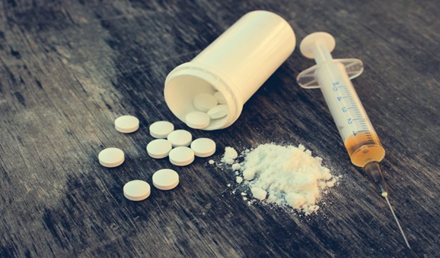
Repeated exposure Leading to Addiction.
Substance addiction (or drug addiction) is a neuropsychiatric disorder characterized by a recurring desire to continue taking the drug despite harmful consequences.
Addiction is caused by the actions of drug abuse and generally requires repeated drug exposure. This process is strongly influenced both by the genetic makeup of the person and by the psychological and social context in which drug use occurs

Slide 7
Neurobiological changes
While early use of a drug may indeed be by choice, the neurobiological changes that occur with continued use, particularly to the prefrontal cortex among other regions related with executive function, compromise inhibitory control which when coupled with physiological and psychological craving for the drug lead to uncontrolled drug use
Thus, it is the mechanisms that occur as a result of taking the drug that make uncontrolled substance use a disorder

Slide 8
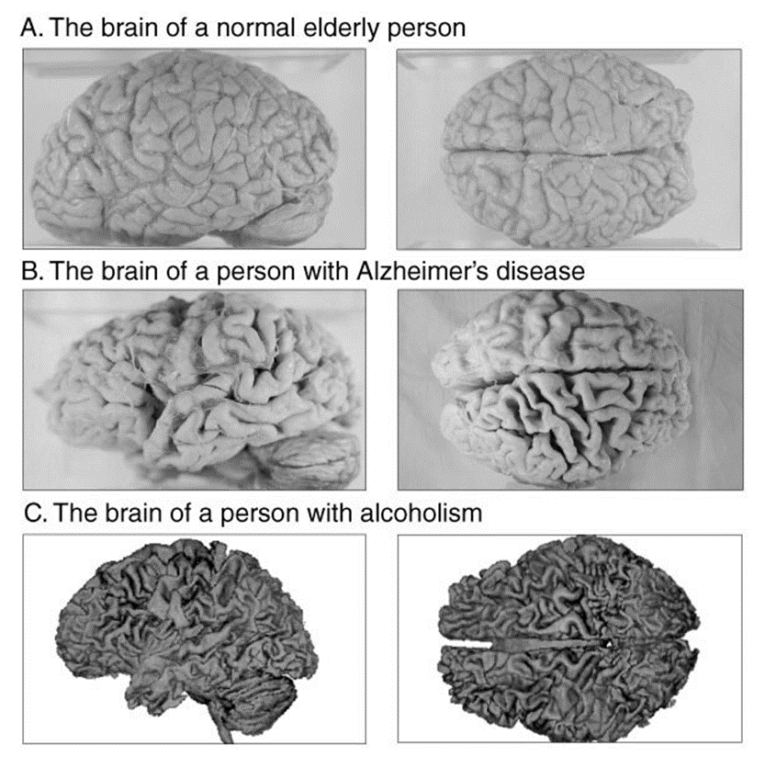
Why drugs lead to abnormal behaviors?
Via neuroimaging technology, experts have observed that chronic drug exposure causes stable changes in the brain at the molecular and cellular level, and that these changes may perhaps underlie behavioral abnormalities

Slide 9
Symptoms
Individuals may experience a variety of different symptoms before deciding to enter a substance abuse treatment clinic. These can include:
Increased tolerance for drugs or alcohol
Failure to fulfill significant life obligations
Difficulties with relationships and increased conflict
An inability to control or reduce drug or alcohol use
Increased time seeking drugs or alcohol
Sacrificing activities to use instead
Poor performance in academics, work
Engaging in dangerous behaviors while under the influence of drugs or alcohol
Experiencing withdrawal symptoms, such as anxiety, sweating, depression, insomnia, tremors, and increased heart rate

Slide 10
Drug Abuse Process
1
2
3
4
Trying the drug
Regular use
Dependence
Substance abuse disorder
Regular use lead to risky use

Slide 11
Substances may cause temporary changes in behavior, emotion, or thought; this cluster of changes is called substance intoxication.
In many cases, people with such a disorder also become physically dependent on the substance, developing a tolerance for it (tolerance :the brain and body’s need for ever larger doses of a drug to produce earlier effects)
When people develop tolerance, they need increasing doses of the substance to produce the effect.
Withdrawal reactions consist of unpleasant and sometimes dangerous symptoms—cramps, anxiety attacks, sweating, nausea—that occur when the person suddenly stops taking or cuts back on the substance

Slide 12
Reasons for doing drugs
Peer pressure
To feel cool
To feel different
Media
Trauma, emotional/physical
Celebration
Boredom
To feel relaxed/to release stress
Media
Friends
Escape

Slide 13
Stimulants
Stimulants are group of substances that increase the activity of the central nervous system, resulting in increased blood pressure and heart rate, more alertness, and sped-up behavior and thinking.

Slide 14
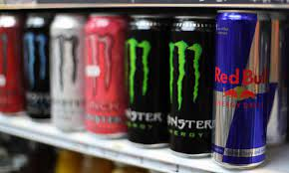
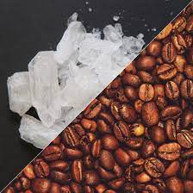
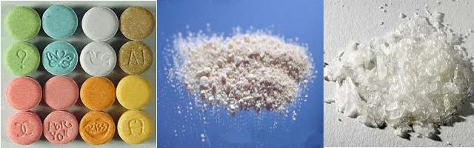
Stimulants (Uppers)
What do they do? Speed up the brain and central nervous system.
Examples: Caffeine (coffee, energy drinks, tea) Nicotine (cigarettes) Amphetamines (meth, ecstasy) “Bath salts” Cocaine and Crack

Slide 15
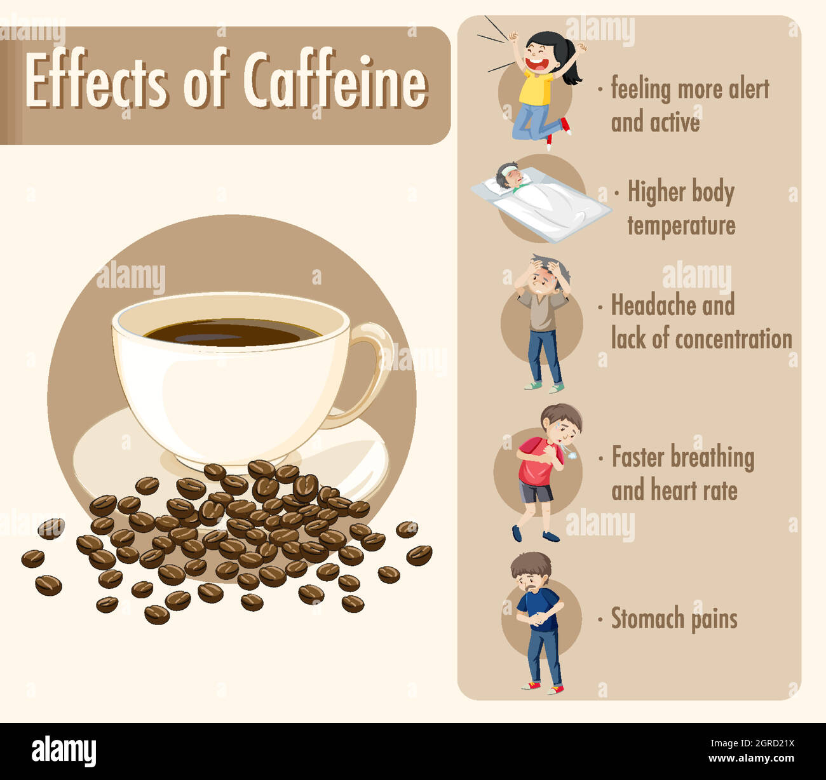
SOME SIDE EFFECTS OF STIMULANTS
Meth Mouth” — rapid decay of a person’s teeth
Weight loss
Drug related psychosis
Organ failure
Death due to stroke, cardiac arrest

Slide 16
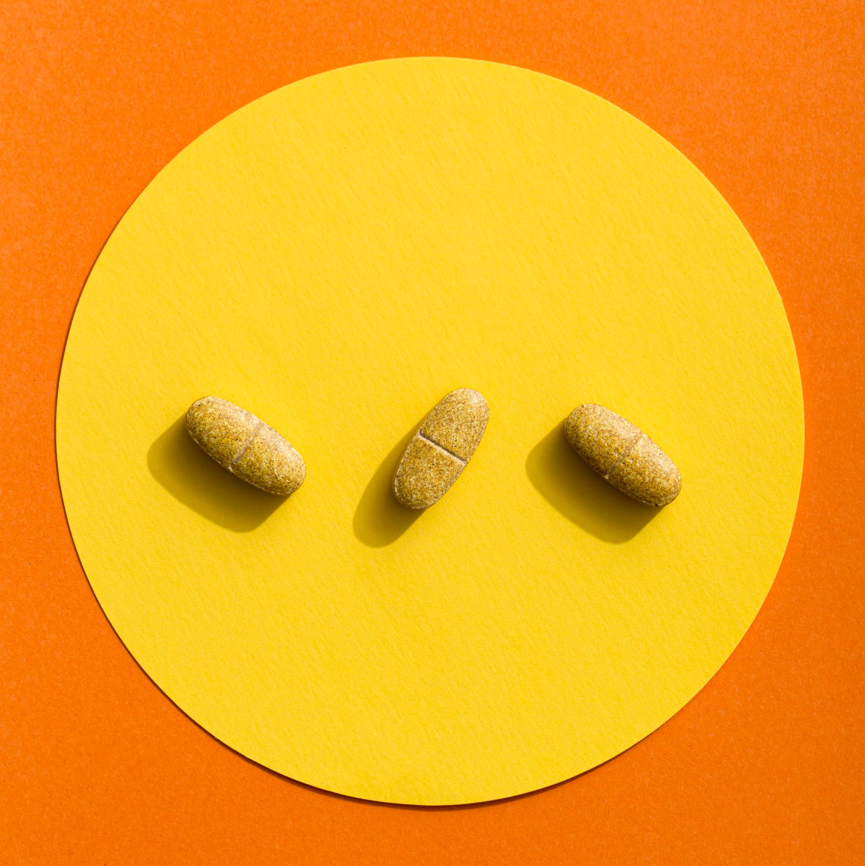
Depressant
Depressants slow the activity of the central nervous system. They reduce tension and inhibitions and may interfere with a person’s judgment, motor activity, and concentration.
The three most widely used groups of depressants are alcohol, sedative hypnotic drugs, and opioids.

Slide 17
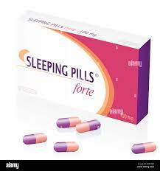
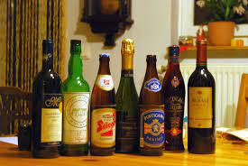
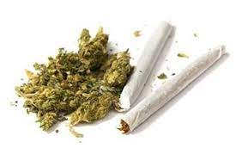
Depressants (Downers)
What do they do? Slow down the brain and central nervous system.
Examples: Alcohol (beer, wine, vodka, tequila, etc.) Heroin Tranquilizers Sleeping Pills Marijuana

Slide 18
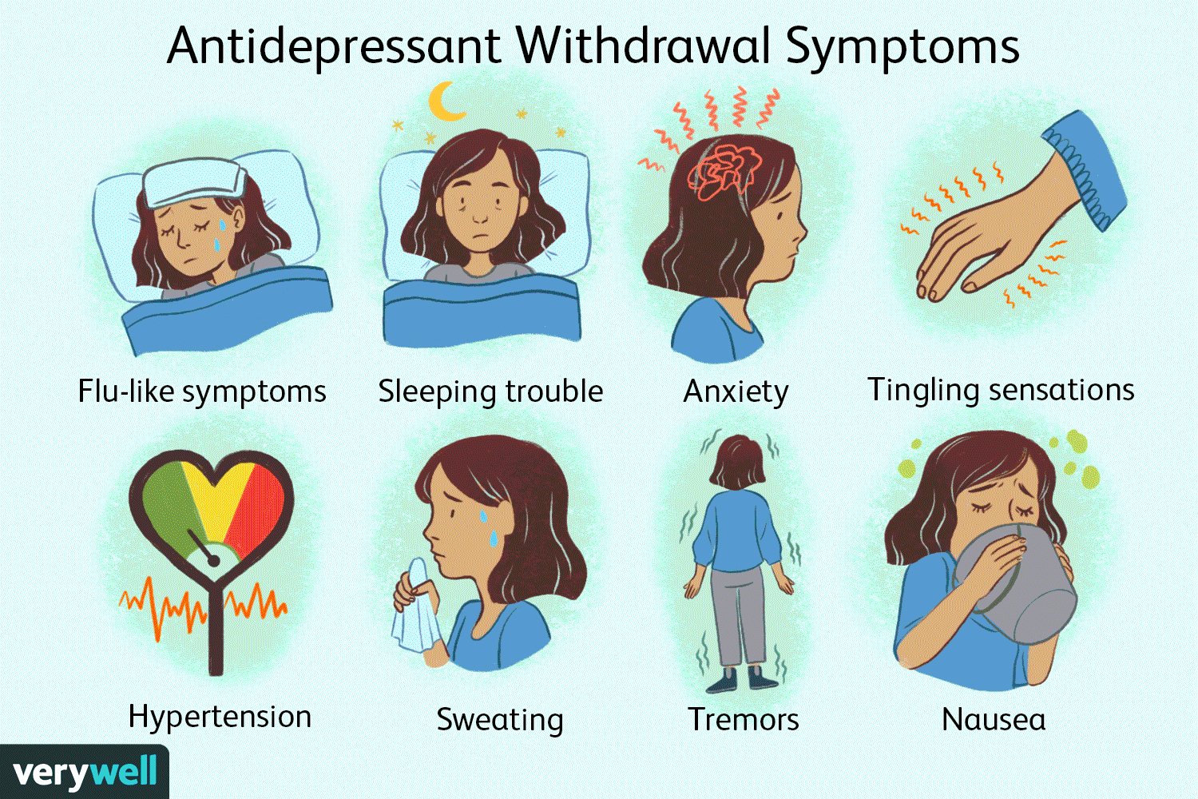
SOME SIDE EFFECTS OF DEPRESSANTS
COMA
Respiratory issues
Lung cancer
Death

Slide 19
Hallucinogin
Hallucinogens are a group of drugs that can alter perception, thoughts, and feelings. Hallucinogens can be taken in a variety of ways: ingested, smoked and inhaled.
These produce powerful changes in sensory perception from strengthening a person’s normal perceptions to inducing illusions and hallucinations
They produce sensations so out of the ordinary that they are sometimes called “trips.”
The trips may be exciting or frightening, depending on how a person’s mind interacts with the drugs. Also called psychedelic drugs

Slide 20
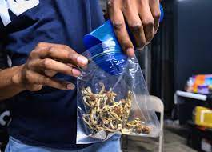
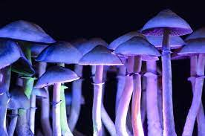
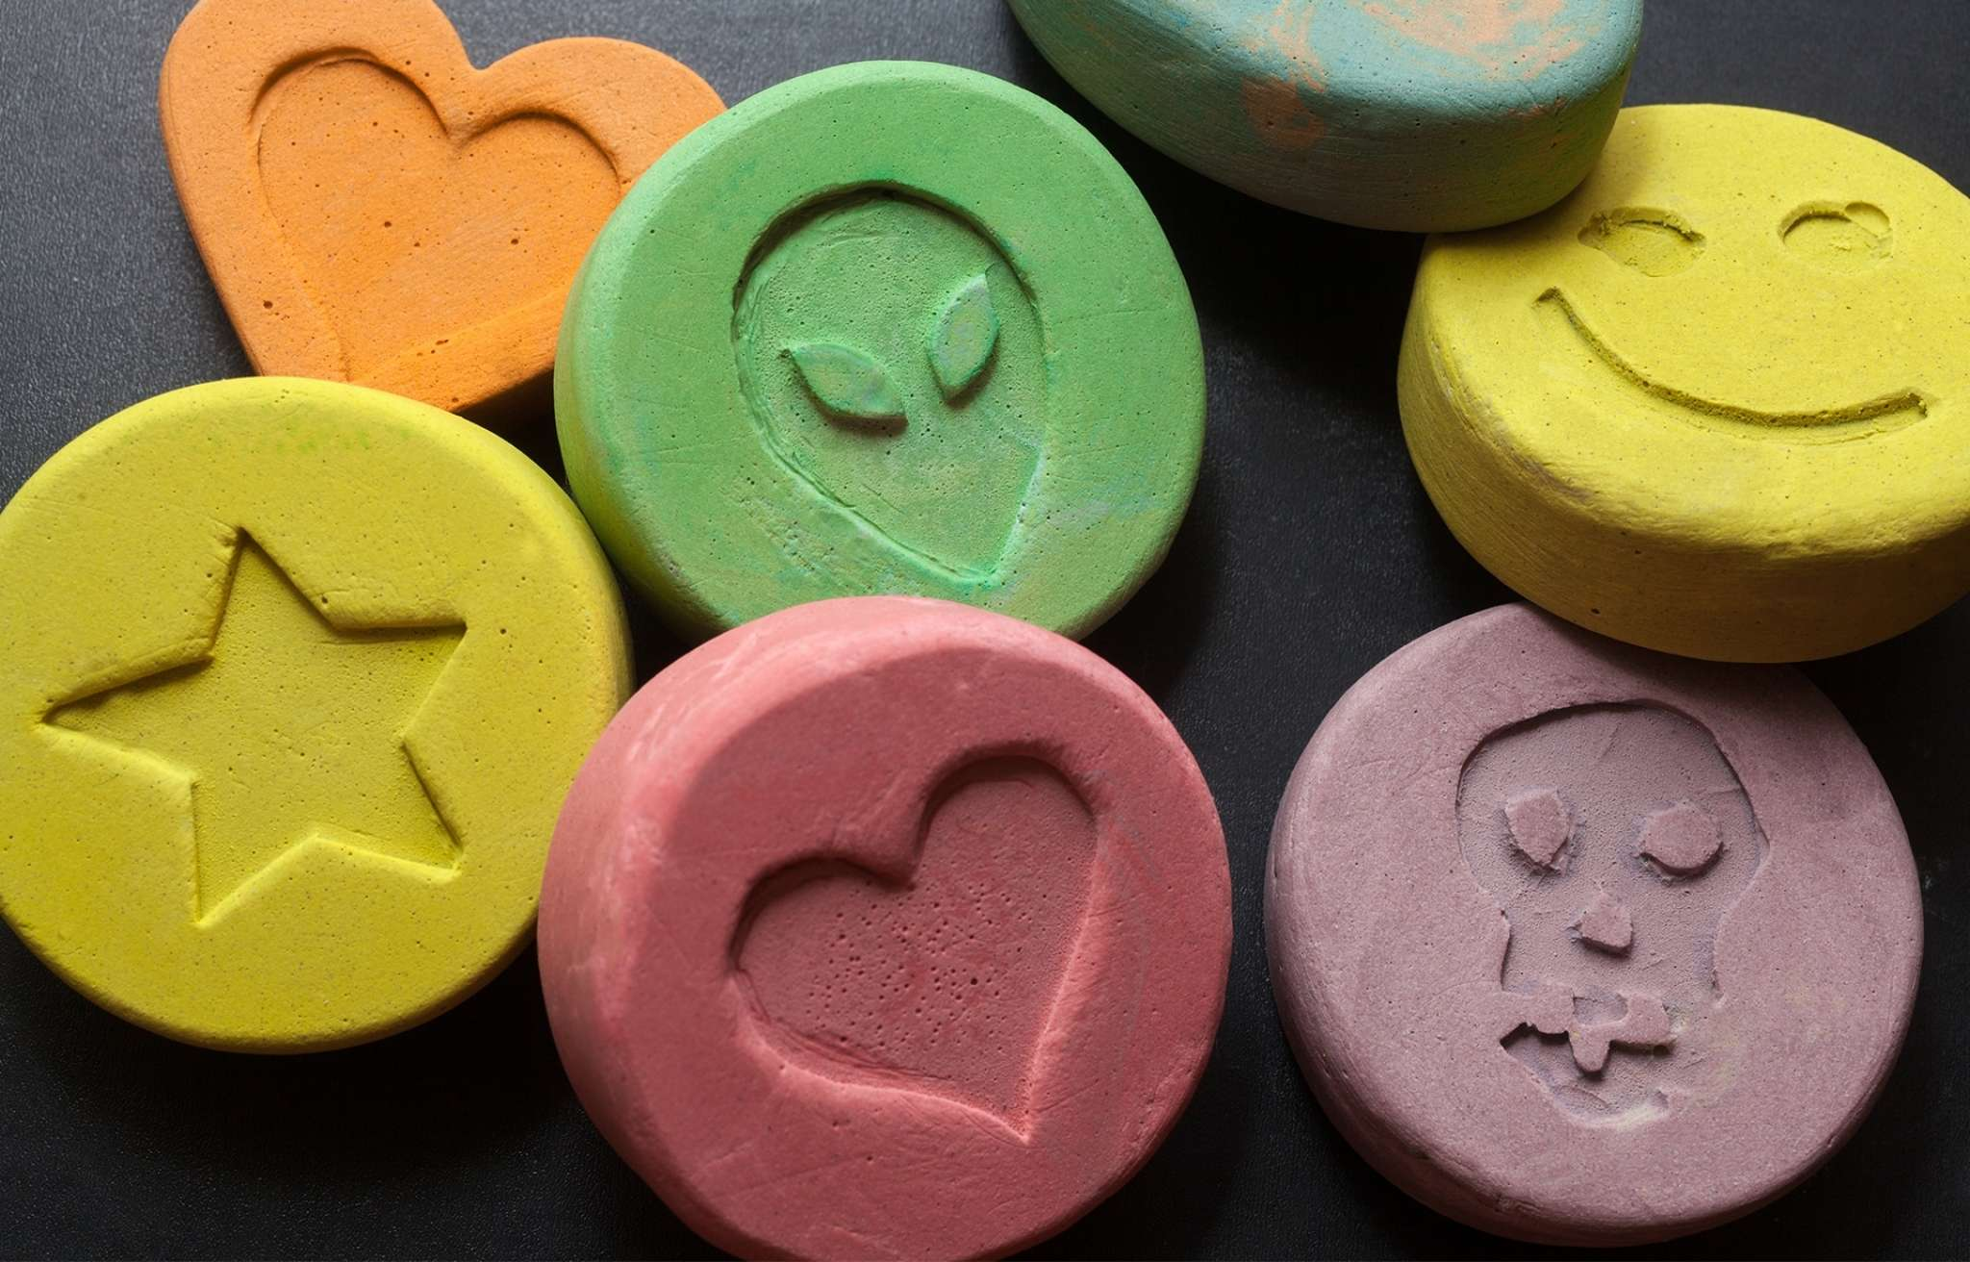
Hallucinogens
What do they do? These drugs alter the user’s state of consciousness. (Distort auditory and visual sensations)
Examples: LSD Ecstasy Magic mushrooms Cannabis

Slide 21
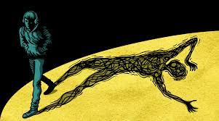
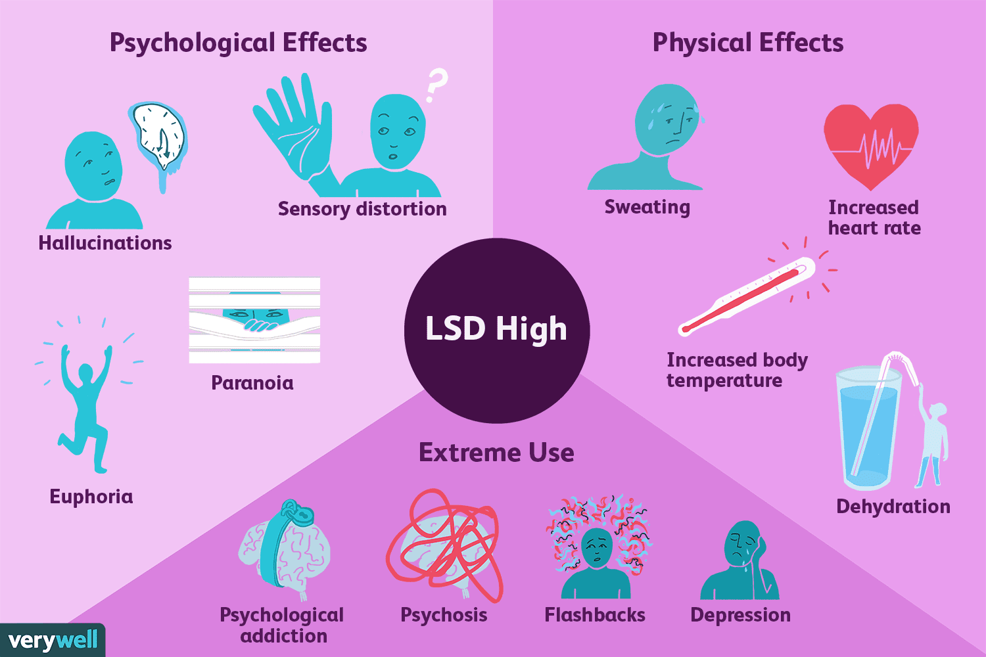
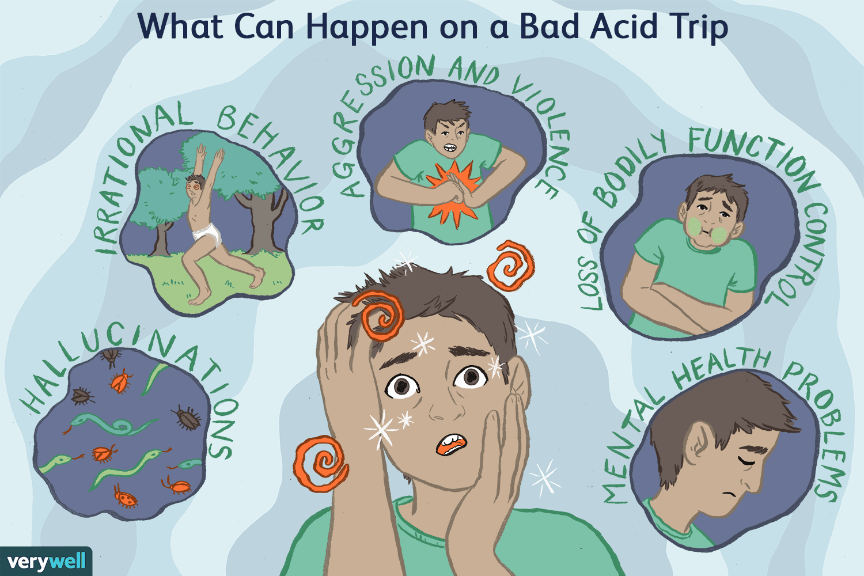
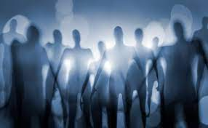

Slide 22
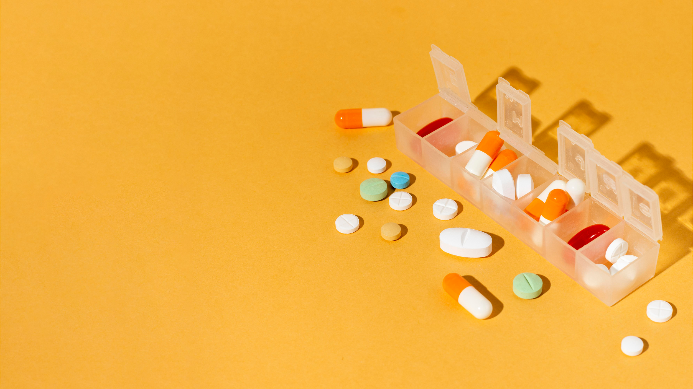
Theory

Slide 23
why people who regularly take substances have tolerance and withdrawal reactions????

Slide 24
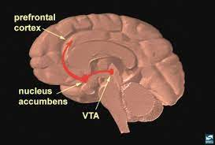
Reward system
A number of brain-imaging studies suggest that many, perhaps all, drugs eventually activate a reward center, or “pleasure pathway,” in the brain (Uroševic´ et al., 2014; de Wit & Phan, 2010). This reward center apparently extends from the brain area called the ventral tegmental area (in the midbrain) to an area known as the nucleus accumbens and on to the frontal cortex (see Figure 12-5).
A key neurotransmitter in this pleasure pathway appears to be dopamine

Slide 25
DRUG ABUSE IS PREVENTABLE & DRUG ADDICTION IS A TREATABLE PROBLEM

Slide 26

CONSEQUENCES OF DRUG USE- SOCIETY
RESULT IN:
JAIL TIME
MASSIVE LEGAL FINES
BECOMING EMPLOYED
HOMELESSNESS
FAILED RELATIONSHIPS WITH FAMILY AND FRIENDS
ADDICTION/DEPENDENCY ON DRUGS LEADING TO MORE CRIME
DEATH

Slide 27
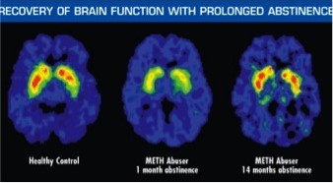
DRUG ABUSE IS PREVENTABLE & DRUG ADDICTION IS A TREATABLE DISEASE
Brains from addicts are different from the brains of people who are not addicted. It is difficult, in some cases impossible, to return the brain to normal. Because drug abuse and addiction have so many dimensions and disrupt so many aspects of an individual's life, treatment is not simple. Effective treatment programs typically incorporate many components, each directed to a particular aspect of the illness and its consequences.
Addiction treatment must help the individual stop using drugs, maintain a drug-free lifestyle, and achieve productive functioning in the family, at work, and in society. Because addiction is typically a chronic disease, people cannot simply stop using drugs for a few days and be cured. Most patients require long-term or repeated episodes of care to achieve the ultimate goal of sustained abstinence and recovery of their lives.

Slide 28
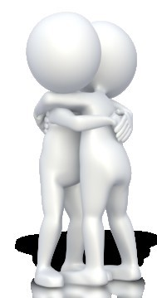
Drug abuse and addiction affect every segment of society. That’s all of us.
Not one person is immune from the disease of addiction.
Prevent drug abuse by :
Being informed of the risks associated with substance abuse
Involvement in alternative activities
Build self-confidence
Make positive future plans
Be brave enough to say “NO!”
Surround yourself with friends who disapprove of drug use
Solve underlying issues that might lead to future
drug abuse with a professional such as a school counselor.

Slide 29
non-substance addiction?

Slide 30
non-substance addiction?
A non-substance addiction includes things such as gambling, risky sex, food, the internet and shopping. These are sometimes called behavioral addictions.
When a person engages in these behaviors in excess and can’t stop, it becomes an addiction.
Non-substance addictions can result in physical, emotional, and financial harm.

Slide 31
EXAMPLES OF NON SUBSTANCDE ADDCITION
Plastic Surgery
Food
Gaming
Plastic Surgery
Sex
Social Media
Gambling
Internet
Risks
Shopping
Pornography

Slide 32
Symptoms of a non-substance addiction
A person with a non-substance addiction is unable to stop doing the troublesome activity or behavior.
For example, a person addicted to gambling may spend all his or her savings. A person addicted to sex may continue to have reckless sex and acquire a sexually transmitted disease (STD). Non-substance addiction symptoms can include:
2. Compulsive, excessive, and repetitive engagement in a risky behavior or activity.
3. Being unable to stop the activity.
4. Impaired judgment.
5. Being unable to control the behavior.
6. Craving the activity or behavior.
7. Being unable to recognize the consequences of the behavior (safety, financial, emotional, physical, death).
8. Strained work and personal relationships.
9. Inappropriate emotional response.

Slide 33
What causes a non-substance addiction?
Studies have shown that gambling activates similar parts of the brain as other drugs, like alcohol. These parts of the brain are responsible for our “reward” functions. This is what gives our bodies’ dopamine after we do some healthy behavior, like exercise or eating a good meal.

Slide 34
How are non-substance addictions diagnosed?
Some people with a non-substance addiction recognize the problem and seek help. Some people are told by family and friends. A mental health professional can diagnose the addiction.
Notes:
https://familydoctor.org/condition/non-substance-addiction/

Slide 35
Thank you
Does anyone have any question?

